Slide 1

Bivariate Regression

Slide 2
Content :
Introduction
“Continuation of Introduction“
Prerequisites
Bivariate Regression
Questions
Conclusion
References

Slide 3


Group Name:
Group Member
1.Shivani Balyan
2. Suraj singh Chauhan

Slide 4
Introduction:
Here, in this project, we will focus on the California population and will try to understand the relation(if there exists such) between the percentage of townspeople who are senior citizens and the total population of the town, and this very scenario would help us to investigate the outliers as well as transformations of both the predictor and the response. We would try to gain some insights from this, for instance, do the towns with higher proportions of senior citizens (over 64 years of age) tend to be staying in larger towns or smaller towns.
Also, as one can observe, the whole thing is revolving around just 2 kinds of variables, hence the term bi-variate regression, which is just another word for a simple linear regression model, is used to predict one variable(dependent variable or the outcome) from another variable(predictor or the independent variable).

Slide 5
Continuation…
We’ll be using some real data, to make our results more realistic! So, our task will be the following:
i. We’ll be importing the “California.txt” named dataset, which is the heart of this project. This dataset contains some census information for 858 towns and cities in California, where some of them are CDP(Census-Designated Place), which means these places have a concentration of population as per United States Census Bureau. For ex. Temelec CDP(Sonoma City).
ii. Next most important item on our list, is to import some libraries, which would be used for our data analysis and visualization.
1. Pandas 2. Numpy 3. Matplotlib 4. Seaborn 5. Scipy

Slide 6
Prerequisites:
iii. The next thing is, we need to make sure we have the proper software, working environment installed in our system. One can have Jupyter Notebook, or Pycharm, or any another such IDE which supports python in order to work with the data.
iv. Here, we’ll be using Jupyter Notebook, and this can run on any system, be it Windows 10, MacOS, or even Linux.
v. Now, as we have all our requirements fulfilled, what are we waiting for?
Let’s go ! And get our hands dirty with the data!

Slide 7
Bivariate Regression
Bivariate Regression Analysis is a type of statistical analysis that can be used during the analysis and reporting stage of quantitative market research . It is often considered the simplest form of regression analysis , and is also known as Ordinary Least- Squares regression or linear regression.
Essentially, Bivariate Regression Analysis involves analysis two variables to establish the strength of the relationship between them. The two variables are frequently denoted as X and Y, with one being an independent variable , while the other is a dependent variable.
Equation , Y=a + bX + e

Slide 8
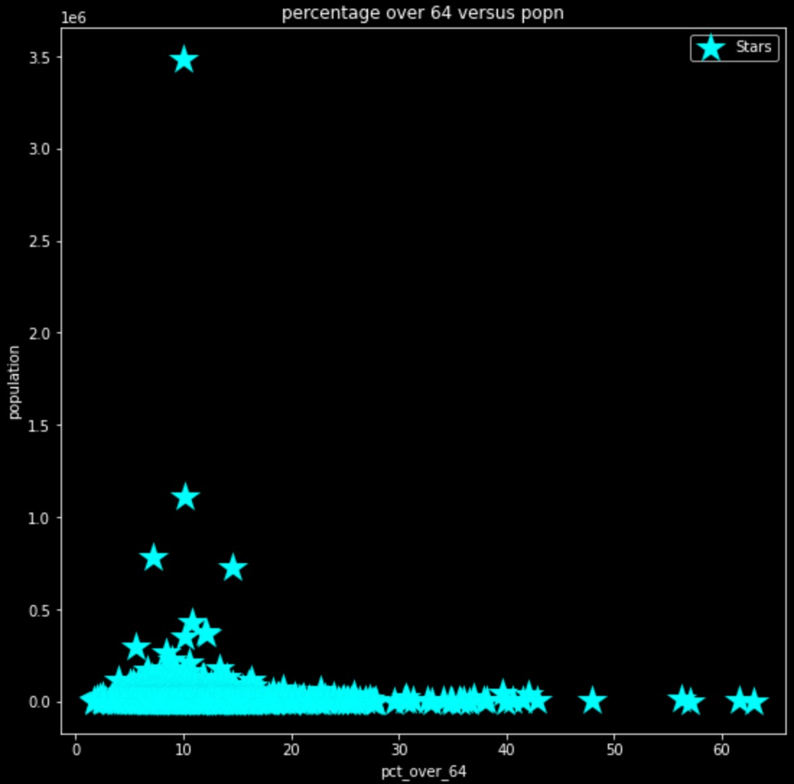
Question 1. Construct a scatter plot between 64 over population versus population . Is this graph helpful?
Answer 1 In the below graph, it is clearly visible that most of the big cities have about 5%-15% of peoples above 64 . So , we can yes this graph is informative and helpful in finding a small relation.

Slide 9
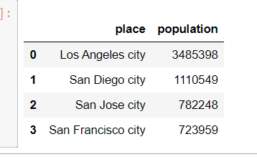
Question 2 Identify the four cities that appear larger than the bulk of the data in the Scatter plot. Answer 2. From this plot we can also conclude that 4 cities have bulk population than others , cities are as Los Angeles city , San Diego city, San Jose city and San Francisco city

Slide 10
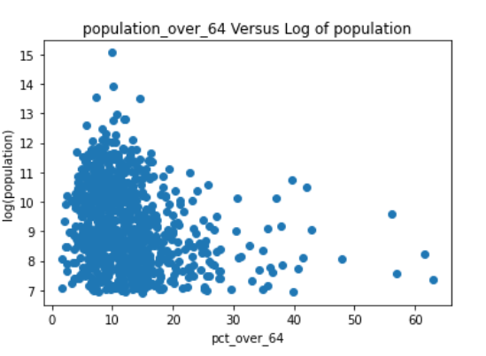
Question 3. Apply ln(log natural) transformation to a predictor ,giving us a transformed predicted variable Note that the application of this transformation is due solely to the skewness inherent to the variable itself (show scatter plot), and is not the result of any regression diagnostic. Perform the regression percentage over 64 and population .

Slide 11
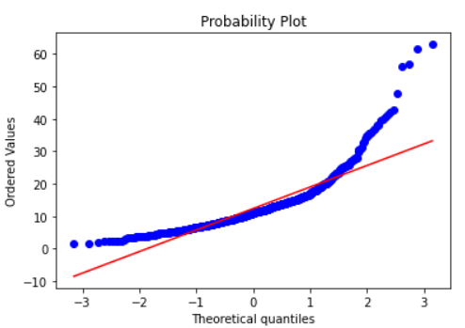
Question 4. Describe the pattern in the normal probability plot of the residuals. What does this mean?
Answer 4. Note: Red line represent fitted values and Blue line represent residual value.
This plot is saying that max people above age 64 belong to 5% - 15% or we can also say it is also right skewed(pct over 64).

Slide 12
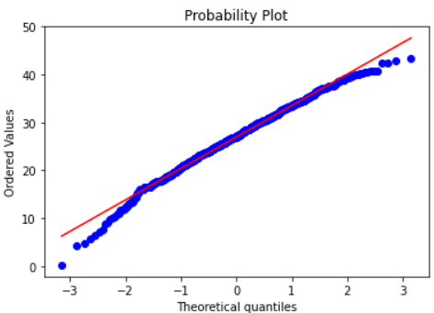
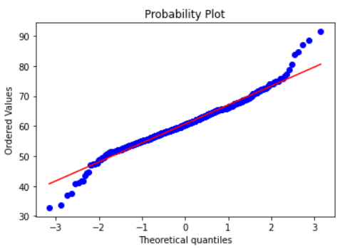
(pct under 18)
From this plot we can say that percentage of age under 18 is linear, that means max cities have same percentage distribution among them of under age 18 people.
(pct between 18 – 64)
From this plot it is clear that the population of this category of peoples are skewed on both sides.

Slide 13
Question 5. Describe the pattern in the plot of the residuals versus fitted values. What does this mean? Are the assumptions validated?
Answer 5. When conducting a residual analysis, a “residuals versus fits plots” is the most frequently created plot. It is a scatter plot of residuals on the y-axis and fitted values (estimated responses) on the x-axis. The plot is used to detect non-linearity, unequal error variance and outliers.
Our dataset shows following pattern:
The plot of pct over 64 shows the right skew.
The plot of pct under 18 shows linearity.
The plot of pct between 18 – 64 shows skew on both the sides.

Slide 14
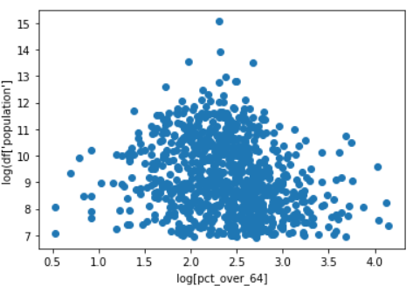
Question 6. Perform the regression of ln pct(ln percentage over 64) on ln popn, and obtain the regression diagnostics. Explain how taking the ln of percentage over 64 has tamed the residuals versus fitted values plot.
Answer 6. As we can see how easily ln has changed our perception over residuals vs fit plot. Now the plot is easy to read and make conclusions.

Slide 15
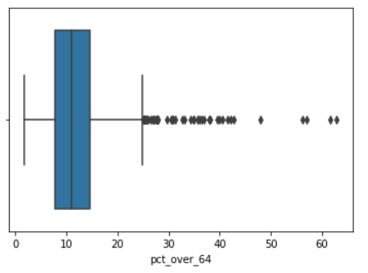
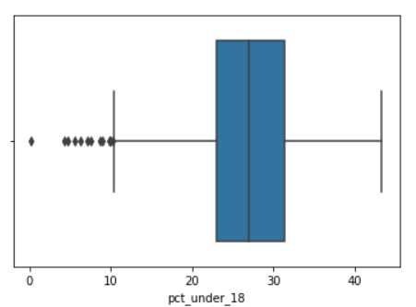
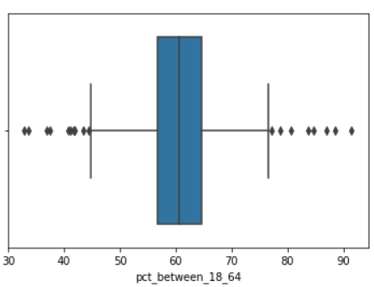
Question 7. Identify the set of outliers in the lower right of the residuals versus fitted values plot. Have we uncovered a natural grouping? Explain how this group would end up in this place in the graph.
Answer 7. Maximum cities have around 5% - 15% people of above age 64, but in small cities population of peoples above age 64 is higher.

Slide 16
Conclusion
From this analysis of population data we have came up with some facts. First thing we came up with is that almost all the cities have nearly same percentage distribution of people below age 18 and the second thing that catches our eyes was the fact that most people of age above 64 live in small cities , that means aged peoples mostly live in the cities with low population as they want peace in their life at the end of their journey .
Usage of this fact :-
This fact can be useful for companies who make products for old aged peoples ,as they now know that what geographical region will be their best target area for maximum sales.
This fact can also be used by government for health care facilities

Slide 17
References:
Wikipedia: The Free Encyclopedia
Matplotlib Documentation
GeeksForGeeks
JavaTpoint
Python libraries documentation
Jupyter Notebook Documentation
Medium: Where Good Ideas Find You
Towards Data Science: A Medium publication sharing concepts, ideas and codes.

Slide 18


